Slide 1
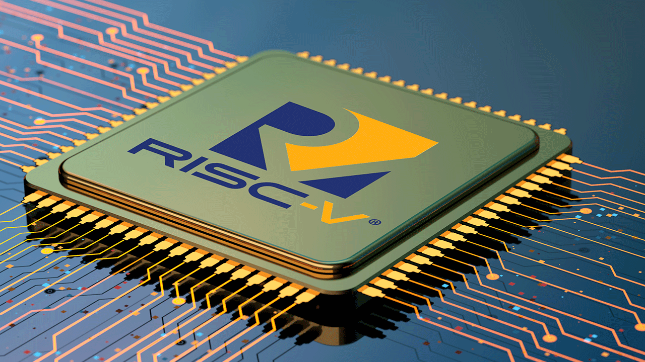
RISC-V Single-Cycle

Slide 2
Introduction
RISC-V (“risk-five”) is an instruction set architecture (ISA) rooted in reduced instruction set computer (RISC) principles. RISC-V is unique, even revolutionary, because it is a common, free, open-source ISA to which software can be ported, hardware can be developed, and processors can be built to support it.

Slide 3
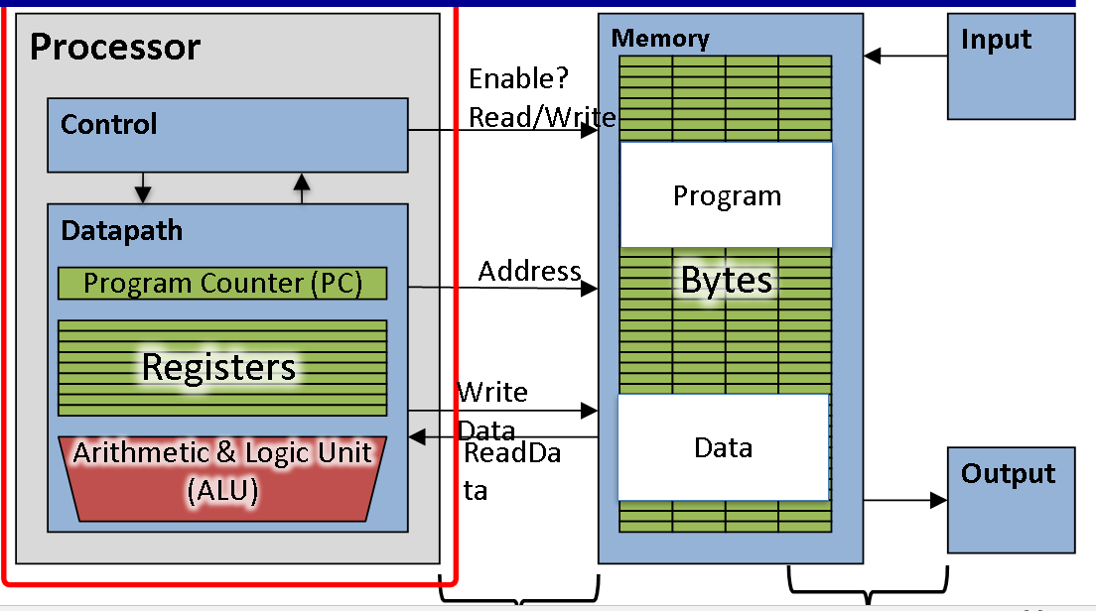
Components of computer

Slide 4
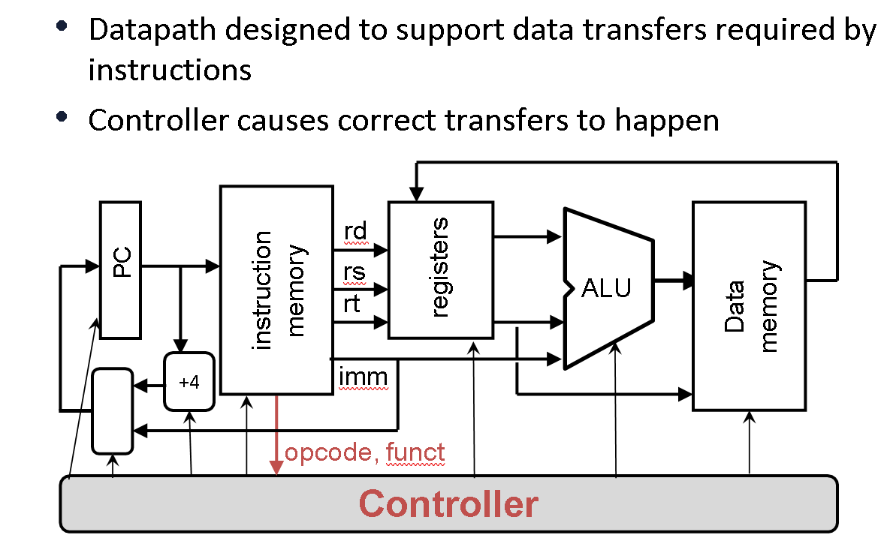
Datapath and Control

Slide 5
• Stage 1: Instruction Fetch
• Stage 2: Instruction Decode
• Stage 3: ALU (Arithmetic-Logic Unit)
• Stage 4: Memory Access
• Stage 5: Register Write
Five stage of instructions

Slide 6
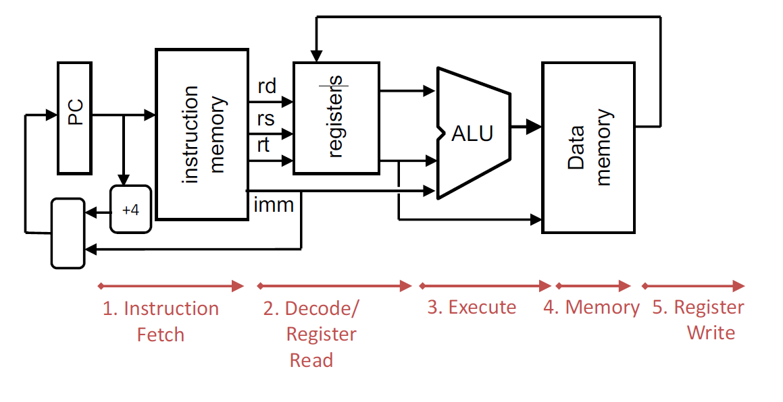
Stages of Execution and Datapath

Slide 7
Stages of Execution
•The 32-bit instruction word must first be fetched from memory.
•The cache-memory hierarchy.
•Increment PC.
•PC = PC + 4, to point to the next instruction.
• byte addressing so + 4.
Stage 1: Instruction Fetch

Slide 8
Stages of Execution
•Instruction Decode: gather data from the fields (decode all necessary instruction data)
•Read the opcode to determine instruction type and field lengths
•Read in data from all necessary registers
•For add/store/conditional branch, read two registers
•For addi/load, read one register
•For jal, no reads necessary
Stage 2: Instruction Fetch

Slide 9
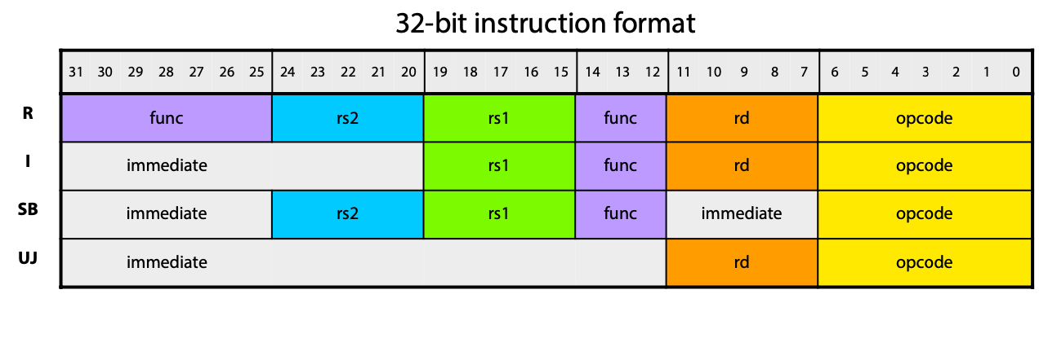
MARKET OVERVIEW

Slide 10
Stages of Execution
•ALU (Arithmetic-Logic Unit): the real work of most instructions is done here.
All operations:
•arithmetic (+, -, *, /), shifting, logic (&, |), comparisons (slt).
•Loads and stores: addition is done
Lw $R4, 40($R1)
•Add to calcuate the the address for accessing memory
•Conditional branch: comparison is done in this stage (one solution).
•BEQ $R3, $R4, 128
Stage 3: Instruction Fetch

Slide 11
Stages of Execution
•Memory Access: only for load and store
•The other instructions remain idle during this stage or skip it all together
•Since load/store have a unique step, we need this extra stage to account for them
•As a result of the cache system, this stage is expected to be fast
•1 cycle ideally
Stage 4: Instruction Fetch

Slide 12
Stages of Execution
•Most instructions write the result of some computation into a register
•Arithmetic, logical, shifts, loads, slt
•For stores, branches, jumps:
Don’t write anything into a register at the end
They remain idle during this fifth stage or skip it all together
Stage 5: Instruction Fetch

Slide 13
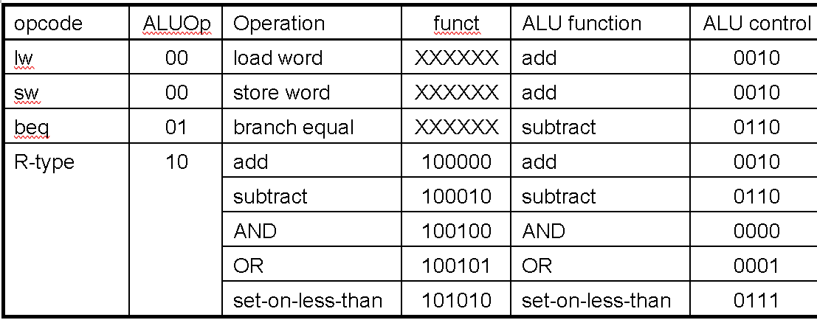
ALU Control

Slide 14
TestBench Results

Slide 15
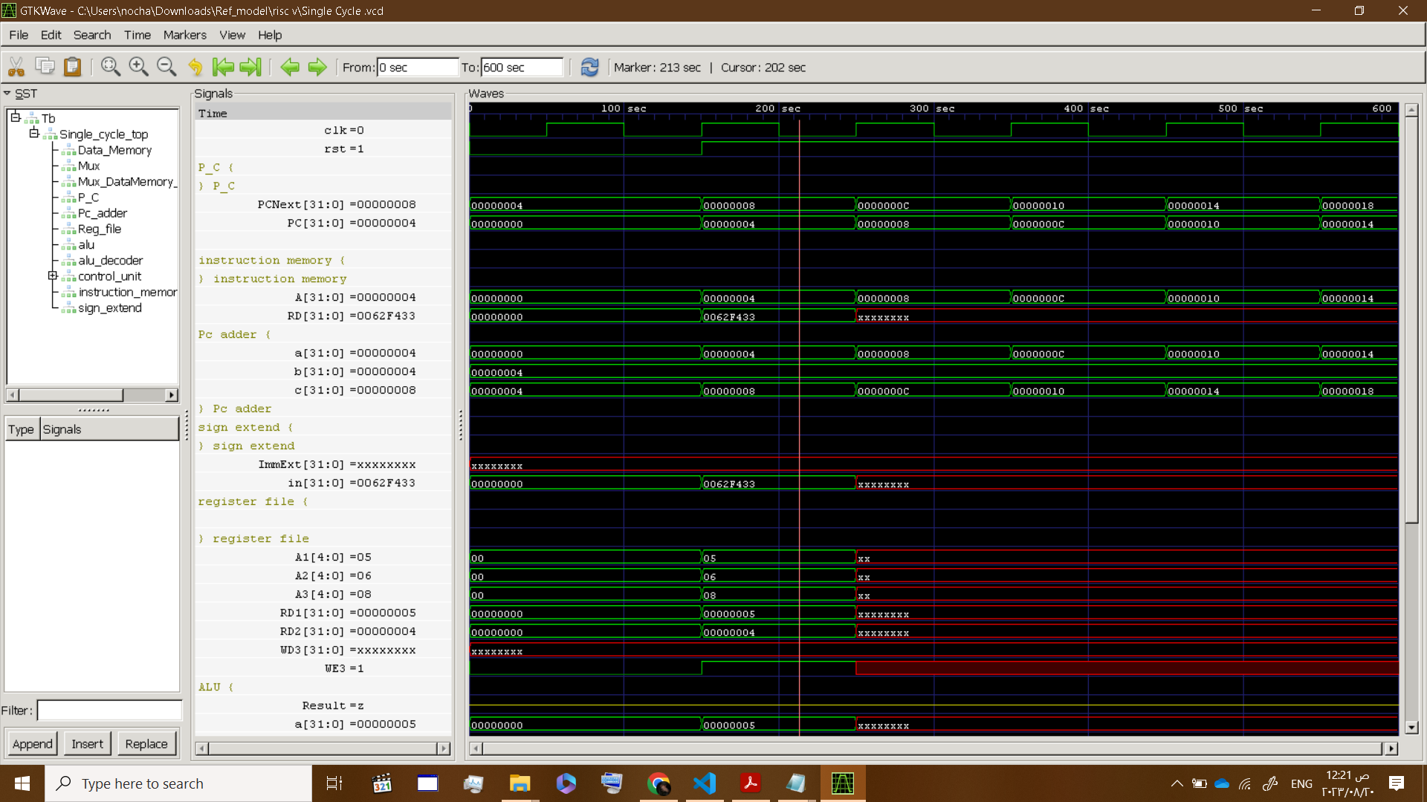
Growth strategy
Feb 20XX
Roll out product to high profile or top-level participants to help establish the product
Mar 20XX
Release the product to the general public and monitor press release and social media accounts
Oct 20XX
Gather feedback and adjust product design as necessary

Slide 16
Alu synthesis

Slide 17
THANK YOU

